Slide 1
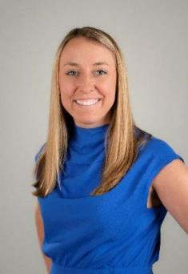
2024 Community Association Legislative and Advocacy Update 2024 Large Scale Managers Workshop September 13, 2024
T. Peter Kristian, CMCA, LSM, PCAM
Hilton Head Plantation Property Owners Association, Inc.
Phoebe E. Neseth, Esq.
Senior Director, CAI Government & Public Affairs

Slide 2
Overview
Federal Legislative Update
National Public Policy Update
State Legislative Update
Notes:
Peter – roadmap the presentation

Slide 3
Federal 2024 Legislative and Policy Update

Slide 4
Overview of Federal Issues
Corporate Transparency Act
Federal Trade Commission Non-Compete Final Rule Update
Federal Communications Commission “Bulk Billing” Notice of Proposed Rulemaking
Disaster Assistance Fairness Act
Notes:
Peter

Slide 5
Corporate Transparency Act
Notes:
Phoebe and Peter cover this topic

Slide 6
The Corporate Transparency Act Summary
The Anti-Money Laundering/Corporate Transparency Act that passed in 2021 and related Business Ownership Information (BOI) reporting requirements through FinCEN, including capturing more beneficial business ownership information, aims to combat illicit activity including:
Tax fraud
Money laundering
Financing for terrorism
This Act unintentionally applies to more than 365,000 community associations in the United States due to associations being organized as state non-profit corporations.
Notes:
Phoebe

Slide 7
Who does the CTA apply to? = Domestic Reporting Companies
APPLIES TO:
Entities created by filing of a document with the Secretary of State, or similar office, of a jurisdiction of the United States
U.S. Corporations
U.S. LLCs
Other similar entities
*Most community associations*
Exemptions: Unless your community association (very large):
Employs more than 20 employees on a full-time basis in the United States;
Filed a Federal income tax return in the United States demonstrating more than $5M in gross receipts of sales; AND
has an operating presence at a physical office within the United States
TAX EXEMPTIONS:
(A) An organization that is described in Section 501(c) of the IRC and exempt from tax under Section 501(a) of the IRC;
• (B) A political organization, as defined in Section 527(e)(1) of the IRC, that is exempt from tax under Section 527(a) of the IRC; or
• (C) A trust described in paragraph (1) or (2) of Section 4947(a) of the IRC.
Notes:
Peter – where these exceptions apply to LSMs

Slide 8
CAI’s Corporate Transparency Act Legislative and Advocacy Efforts
CAI recognizes this is an ill-conceived statute that is overburdensome, impractical, and likely ineffective.
1. Urging an exemption for community associations
December 2023 - CAI sent a letter to the U.S. Treasury Department urging their consideration of an exemption for all community associations and is email all members of Congress.
July 2024 – H.R. 9045 introduced by Rep. McCormick (R-GA) to exempt community associations
2. Urging a delay of implementation
Supporting H.R. 5119/S.3625 – the Protect Small Business and Prevent Illicit Financial Activity Act – to delay reporting requirements for one year.
COALITION WORK: Bipartisan group of 80 congressional members urged the Financial Crimes Enforcement Network to implement a one-year delay. 130 trade association coalition urged the Banking Committee to pass this delay.
Notes:
Phoebe

Slide 9
Judicial Efforts and Update by Stakeholders Federal Court Rules Corporate Transparency Act Unconstitutional
March 1st – Alabama Federal Court rules in favor of NSBA, and its members as of March 1st, ruling the CTA is unconstitutional
March 11th – the Federal Government (DOJ & US Treasury) appeal this decision to the 11th Circuit
CAI Amicus filed May 20th during the appeal process and met with FinCEN staff
September 10, 2024– CAI filed a lawsuit in Federal District Court arguing for a community association exemption
Notes:
Phoebe

Slide 10
ACT NOW: URGE YOUR MEMBER OF CONGRESS TO REQUEST A CTA EXEMPTION FOR COMMUNITY ASSOCIATIONS FROM FinCEN!
Notes:
Phoebe

Slide 11
Federal Trade Commission: Non-Compete Final Rule Update
Notes:
Peter

Slide 12
Federal Trade Commission’s Non-Compete Ban
April 2024 - A federal court issued a nationwide injunction barring enforcement of the FTC’s ban on non-compete provisions in employment contracts – scheduled to become effective on September 4, 2024
August 20th – federal court invalidated the FTC’s ban on most non-compete provisions; Judge Ada Brown wrote that the final rule “shall not be enforced or otherwise take effect on September 4, 2024, or thereafter,” holding that the rule was arbitrary and capricious as the FTC.
Takeaway: Employers currently do not need to take action regarding non-compete provisions, but the FTC will likely appeal to the 5th Circuit. Injunction took effect September 4, 2024.
Notes:
Peter

Slide 13
Disaster Assistance Fairness Act
Notes:
Phoebe

Slide 14
Disaster Assistance Fairness Act: Disaster Response and Recovery
Notes:
Phoebe

Slide 15
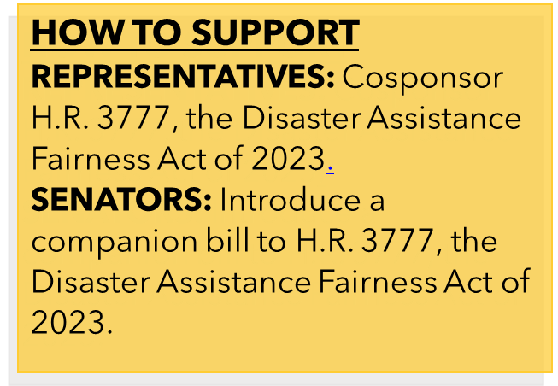
Support H.R. 3777 – Disaster Assistance Fairness Act and Act Now!
Notes:
Phoebe

Slide 16
Federal Communications Commission (FCC) “Bulk-Billing” Notice of Proposed Rulemaking
Notes:
Peter

Slide 17
FCC “Bulk-Billing”
March 2024 – FCC announced a potential notice of proposed rulemaking related to apartment and condominium “bulk purchases” of media services.
Industry Impact:
Would disincentivize providers’ investment in broadband services, particularly for low-income and smaller properties
Likely lead to increased costs for services
CAI Next Steps:
Federal team has been in touch with FCC staff and no indications yet that the NPRM is forthcoming
White House has been searching with federal agencies (like FCC) for items to add to its “junk fee agenda”
Notes:
Peter

Slide 18
National Public Policy Update
Notes:
Peter

Slide 19
2024 National Public Policy Update
Board Member Education Public Policy
Dispute Resolution Public Policy
Foreclosure and Fining Authority Public Policy
Notes:
Peter

Slide 20
Board Member Education Public Policy Updates Approved by Board of Trustees June 2024
CAI’s legislative action committees can now support legislation that:
Mandates board member education if the requirements include proper terms and nuances including:
Training within 90 days of being elected appointed
At least two (2) hours of online or in-person training; and every three (3) years after while remaining on the board
Certain industry topics are included in the training (ex. Industry federal/state statutes; governing documents; fiduciary duties; ethics; procedures, etc.
CAI will not actively pursue mandatory training legislation
GOAL: to ensure a balanced stance and acknowledge the importance of board member education while recognizing the potential downside of mandatory training requirements and seeking to support effective and practical solutions.
Notes:
Peter

Slide 21
Dispute Resolution Public Policy Being Reviewed by CAI Public Policy Task Force
Current Public Policy: CAI advocates that communities adopt policy resolutions to offer ADR for housing-related disputes between individual unit owners as well as between owners and the association.
Potential Updates: broaden a LAC’s ability to be more flexible when navigating state mandates related to dispute resolution in community associations
Reasoning for updates: increase in state legislation mandating alternative dispute resolution and creating state Ombudsman programs
Notes:
Phoebe

Slide 22
Foreclosure and Fining Public Policy Being reviewed by CAI Public Policy Task Force
Current Public Policy: CAI supports and advocates for a fair and equitable foreclosure process by community associations that: (1) provides timely notice to owners and gives owners a reasonable opportunity to cure any default prior to foreclosure; (2) allows a reasonable amount of time for owners to cure a default as the foreclosure proceeds; (3) promotes reasonable expenses and costs of the foreclosure process; and (4) provides notice to all other lien holders of record (or required by law) so that lien holders have the right to either exercise their right to foreclose or participate in the process.
Potential Updates: Prohibit foreclosures when it comes to fine violations
Reasoning for updates: increased state legislation mitigating a community association’s ability to foreclosure
Notes:
Peter

Slide 23
State 2024 Legislative and Policy Update
Notes:
Phoebe

Slide 24
2024 State Legislative Affairs
2024 Priorities
Condominium Safety: Building Inspections, Reserve Studies/Funding
Fining Authority and Foreclosures
Dispute Resolution and ADR
Process to Remove Discriminatory Covenants
Board member education
Access to affordable insurance
Energy Efficiency – Solar panels and electric vehicle charging stations
46 States in Session (MT, ND, NV, & TX every odd year)
37 Legislative Action Committees and….Delaware, Iowa, Kansas, Louisiana, Mississippi, Nebraska, Oklahoma, West Virginia, Vermont
More than 1,200 bills tracked
Notes:
Phoebe

Slide 25
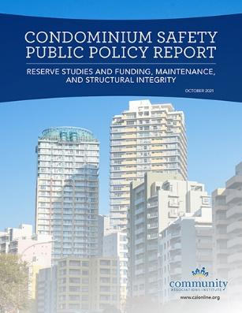
Condominium Collapse Tragedy www.caionline.org/condosafety
CAI’s Government & Public Affairs Committee held its first discussion at the end of June.
Three Task Forces with hundreds of people from throughout the U.S. and Canada serving on the task forces
Research of laws and ordinances in the U.S. and internationally (Australia, Ontario, Singapore, and Spain)
Conversations with Condo Safety Coalition; including NIST, NLC, NSPE, NACO, Building Inspectors, ICC, NAHC, etc.
Vetting through 43,000 members; including six hundred legislative committee members
Final approval by CAI’s Board of Trustees
Notes:
Peter

Slide 26
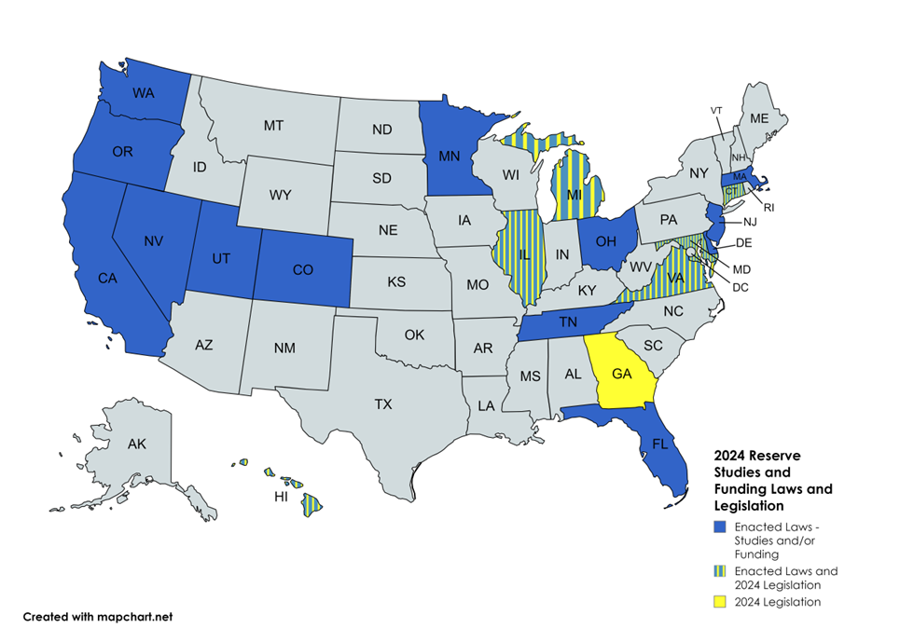
Reserve Study and Funding Laws and Legislation
Reserve Study Condo Laws = 13 states
↑ 3 since 2021
Reserve Funding Condo Laws = 12 states
↑ 2 since 2021
2024 Legislation = 7 states
CAI supports mandated reserve studies and funding for new community developments and periodic reserve studies for communities with major shared components.
Notes:
Peter

Slide 27
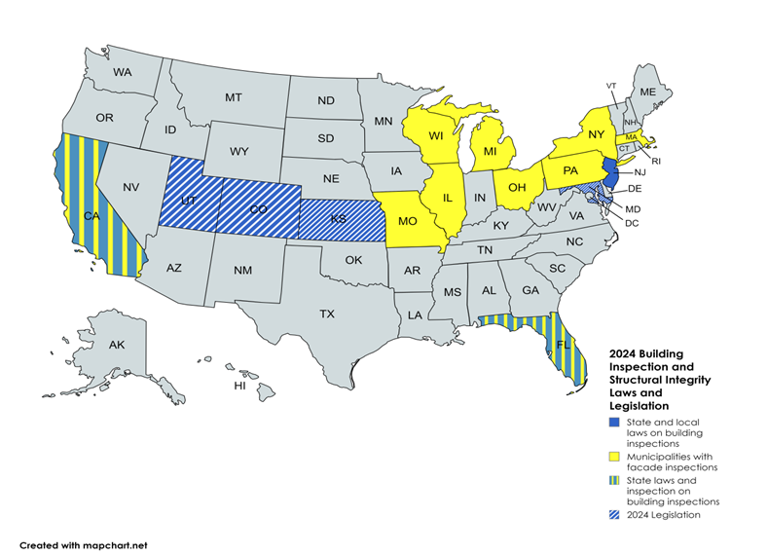
Building Inspections and Structural Integrity Laws and Legislation
Façade State Law = CA (balcony)
Building Inspection State Law = CA, FL, NJ
↑ 2 states since 2021
Legislation = 6 states
CAI supports state law that provides for mandatory building inspections and ongoing reviews of the major structural elements, owned, or maintained by the community association.
Notes:
Phoebe

Slide 28
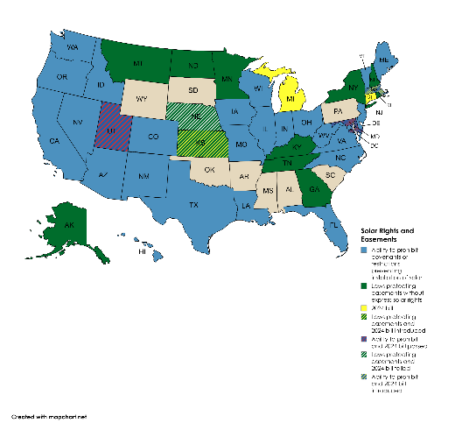
Solar Device Laws and Legislation
​​​​​​​​​​​CAI supports environmental and energy efficiency policies that recognize and respect the governance and contractual obligations of community association residents as the best mechanism to enact sustainable environmental policies.
CAI supports efforts by state legislatures to empower community associations to build consensus-based solutions regarding environmental initiatives, and opposes government and interest group efforts to override community policy or deed restrictions on single interest issues.​
Laws = 28 states
2024 Legislation = 22 states
Notes:
Peter

Slide 29
Fining Authority and Foreclosure Ability Legislation
CAI endorses legislation that provides a fair and equitable foreclosure process that protects homeowners, property values, and the financial health of community associations by ensuring foreclosures by community associations are completed in a timely and reasonable manner.
7 States introduced legislation in 2024 limiting an association’s ability to foreclose.
Notes:
Peter

Slide 30
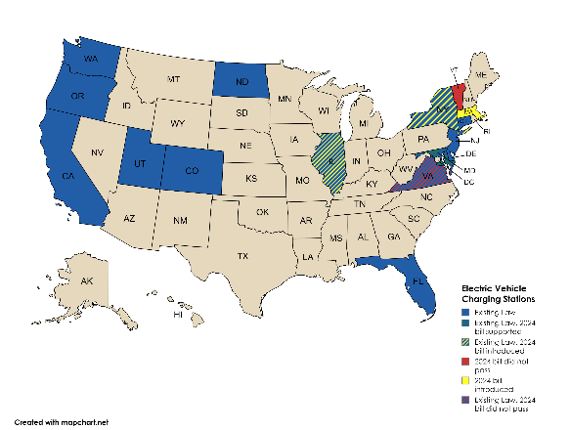
Electric Vehicle Charging Station Laws and Legislation
​​​​​​​​Communities should determine the most efficient, fair, and effective method to provide electric vehicle charging stations.
Legislation or policy must respect the financial capability of associations to provide for the stations and allow associations to equitably allocate the cost of the charging stations to those who benefit.
Laws = 9 states (7 reviewing updates)
Legislation = 18 states
Notes:
Phoebe

Slide 31
CAI National Advocacy Resources for Success and Engagement
Notes:
If we have time – we both can run through these resources

Slide 32
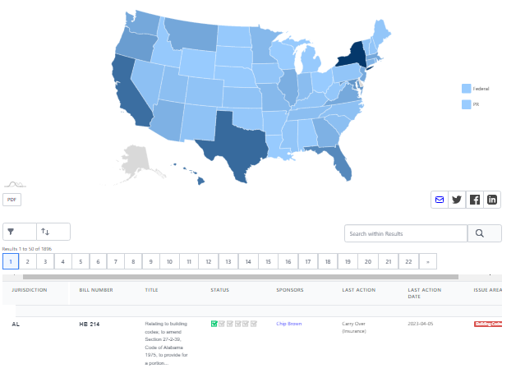
CAI Legislative Tracking and Policy Map
www.caionline.org/legislativetracking

Slide 33
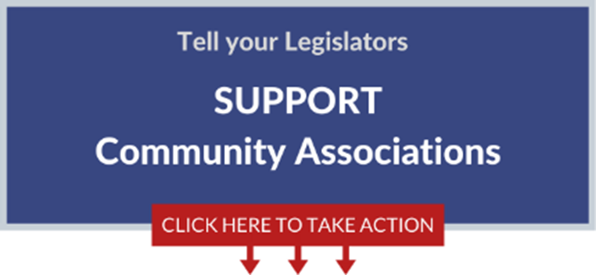
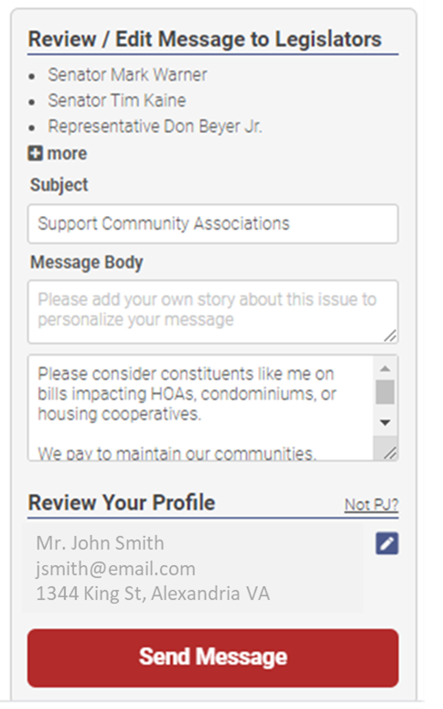
Take Action Email and Text Campaigns
www.caionline.org/takeaction

Slide 34
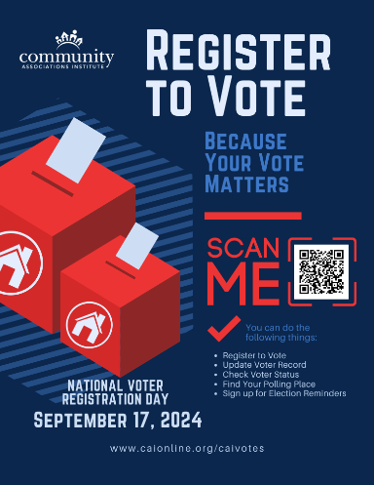
Get Out The Vote – Share Voter Resources in Your Community this Election Year!
Download CAI’s Voter Resources Here:

Slide 36
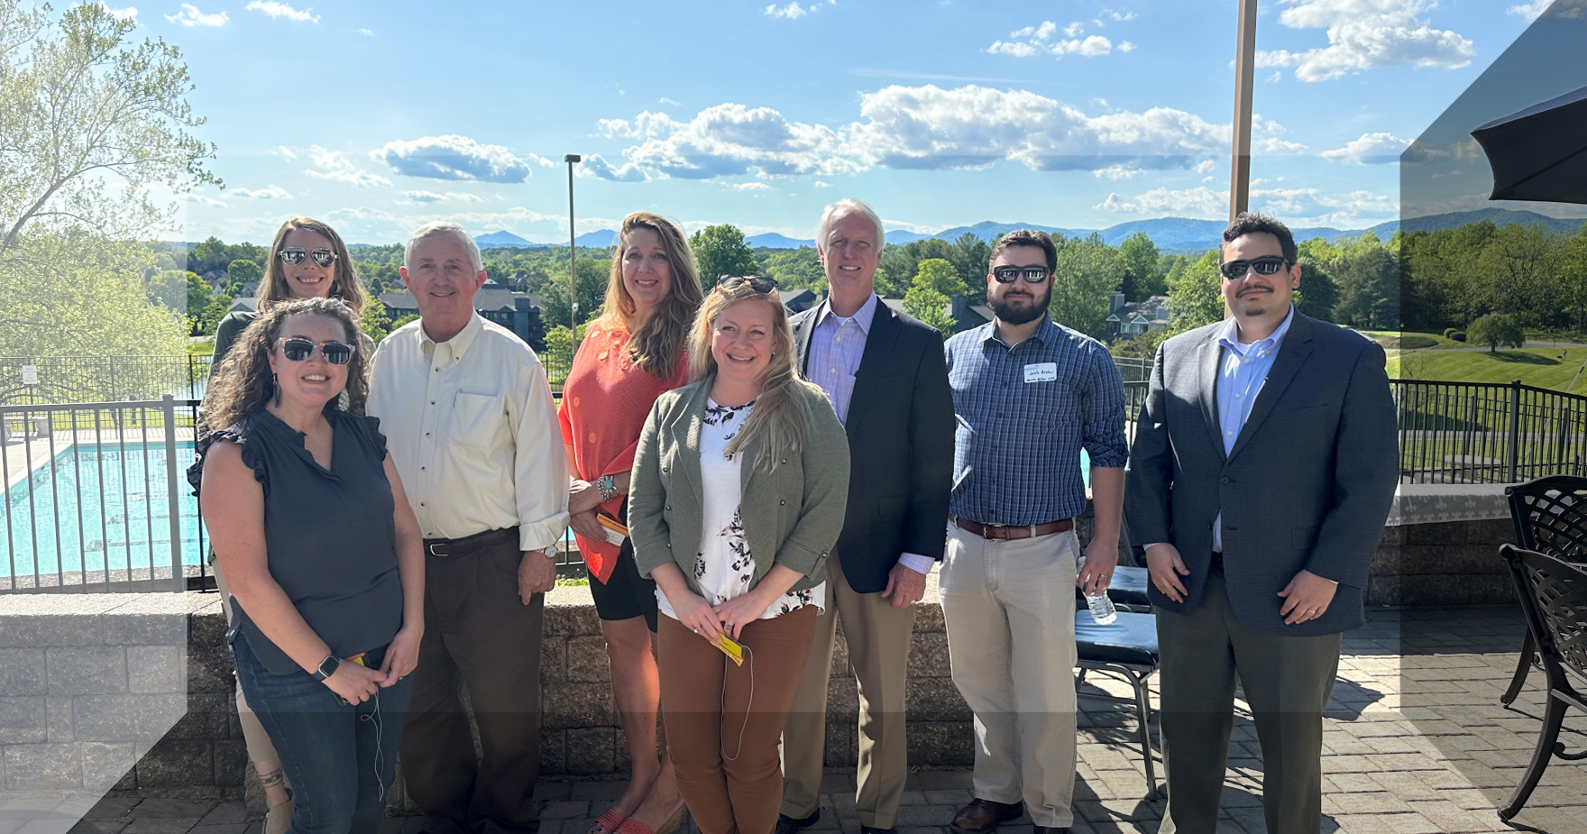
CAI Southwest Virginia Chapter – CIYC Event in Lynchburg, Virginia – May 2023

Slide 37
Become a CAI Advocacy Ambassador TODAY!
Ambassadors will recruit, organize, and motivate other advocates. If an advocacy issue arises in your area, you will be called upon to help get the word out so that CAI has a stronger voice with legislators.
Roles:
Homeowner Leader Ambassadors
Manager Ambassadors
Management Company Champions
Real Estate Agent/Broker Ambassadors
District Ambassadors
www.caionline.org/takeaction

Slide 38
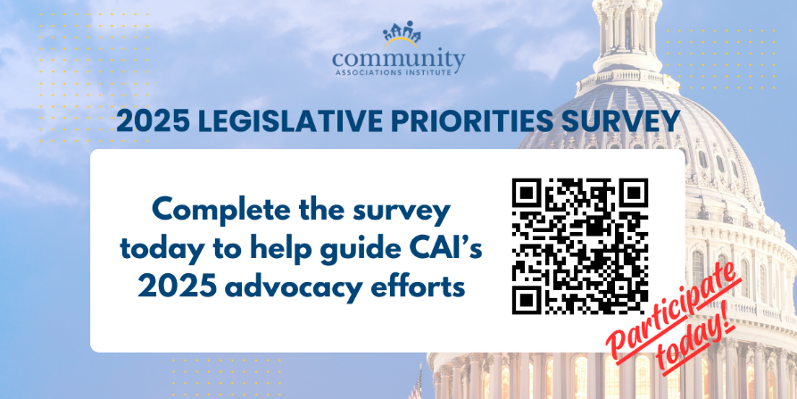

Slide 39
Stay in Touch with CAI’s Advocacy Efforts!
Follow us on Twitter @CAIAdvocacy
Email us at government@caionline.org
Subscribe to the Advocacy Blog

Slide 40
2024 Community Association Legislative and Advocacy Update 2024 Large Scale Managers Workshop September 13, 2024
T. Peter Kristian, CMCA, LSM, PCAM
Hilton Head Plantation Property Owners Association, Inc.
Phoebe E. Neseth, Esq.
Senior Director, CAI Government & Public Affairs

