Slide 1
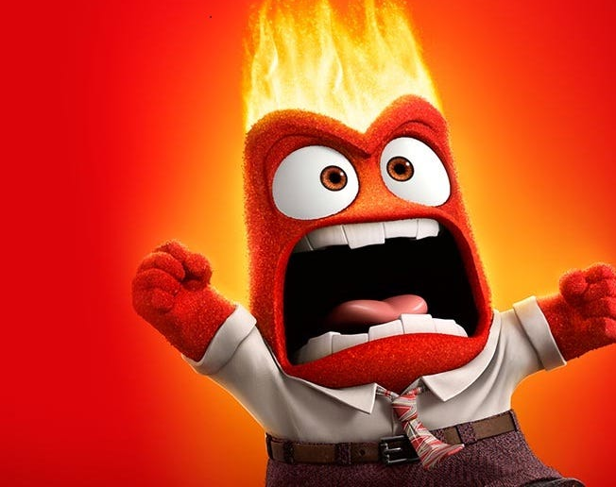
Communication and Burnout a/k/a How to talk to people without losing your sh*t
Ursula Burgess, Esq. CCAL
Rees Broome, PC

Slide 2
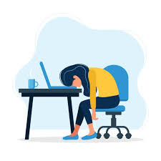
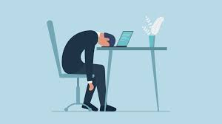
What is burnout?
Extreme tiredness or mental or physical illness caused by working too hard or trying to do too much (Cambridge dictionary)
exhaustion of physical or emotional strength or motivation usually as a result of prolonged stress or frustration (Miriam Webster)
physical or mental collapse caused by overwork or stress. (Dictionary.com)

Slide 3
Some truths…..
This is a high-pressure profession.
You can’t control anyone except yourself.
You love what you do.
You will always receive negative feedback – deserved or not.
You will always have limited control over your schedule.
People are needy.**
Notes:
77 LSMs. 77is a small number of dedicated people. And you are here on a Saturday morning.

Slide 4
Tips and tricks to improve communications that you have with members, board members and business partners.

Slide 5
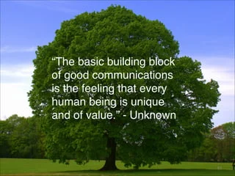

Slide 6
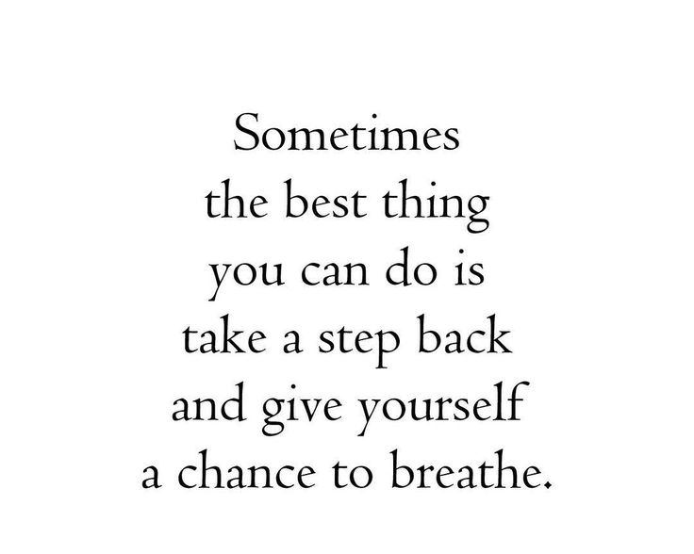

Slide 7
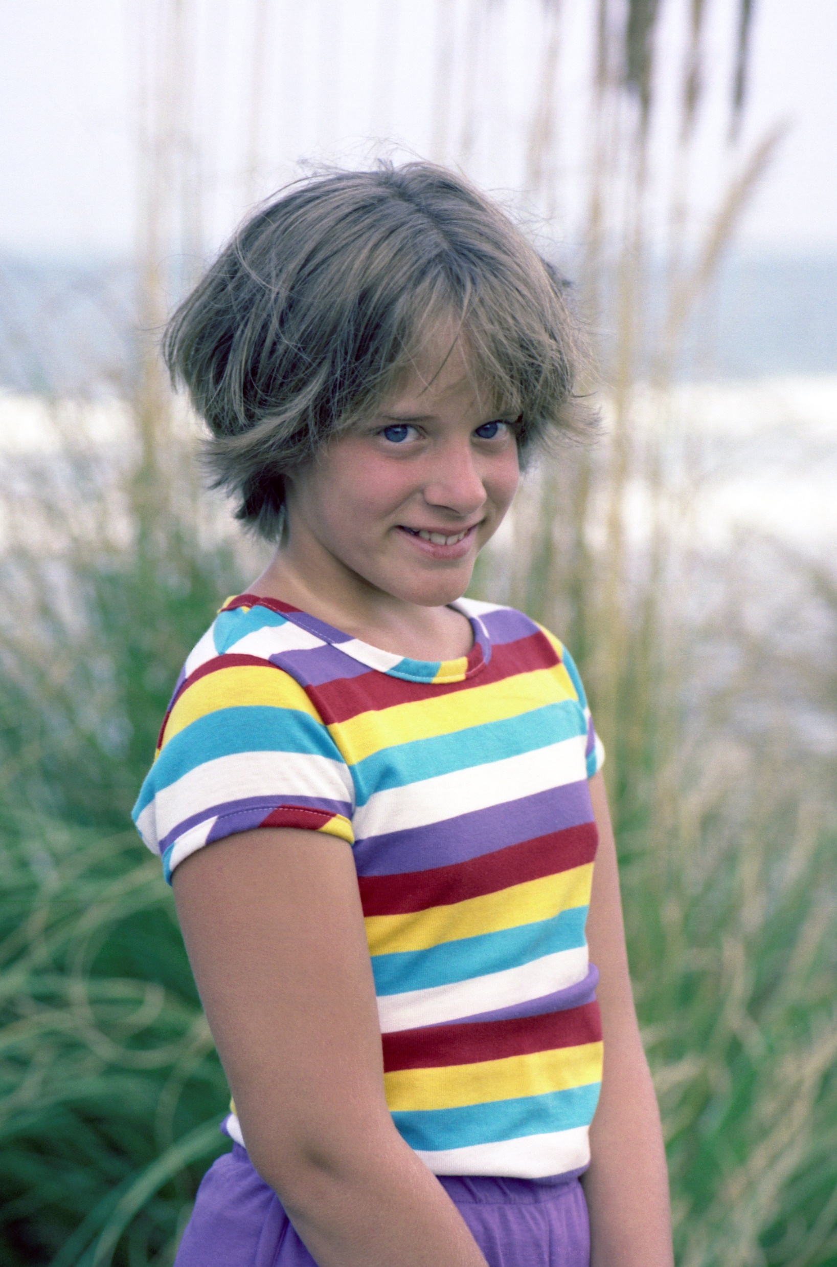
Thank you for your email….
Thank you for your concerns regarding the board’s decision….
We appreciate your involvement with the community ….

Slide 9
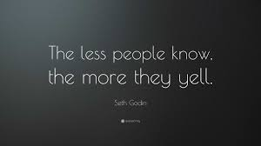

Slide 10
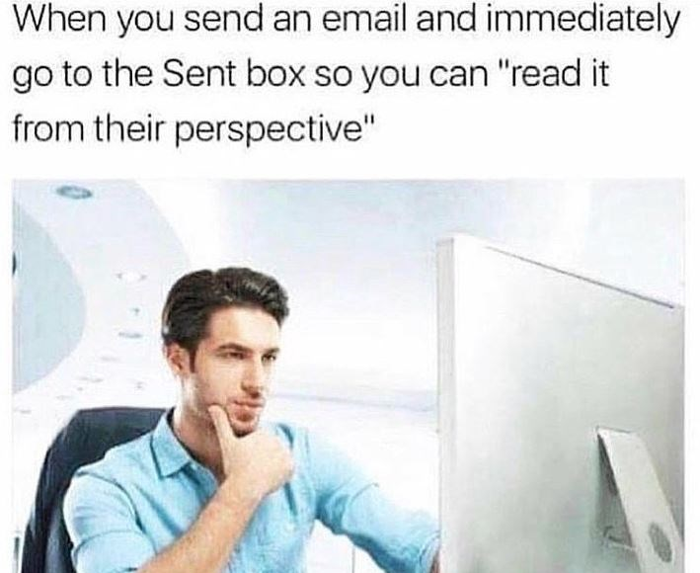
Go back to the basics….
Who, What, When, Where, Why and How
Use good grammar, spelling and punctuation
If this then what? Be clear on consequences/actions
If you don’t respond by ….
If you don’t take corrective action by ….
Re-read your email before sending it.
How would you react if you received this email?
Would you have lingering questions?

Slide 11
And then use technology

Slide 12
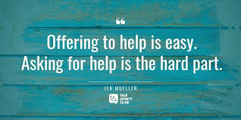
When you need more …

Slide 13
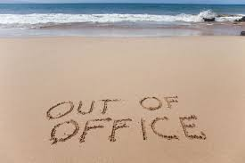
And then….

